Slide 1
Project Scope Management
Project Management
Paul Vesey
Limerick Institute of Technology
paul.vesey@lit.ie
Autumn 2019

Slide 2
Project Management
Project Scope Management Introduction
Scope Management
Primarily concerned with what is and what is not included in a project.
Processes (not in PMBOK order)
Collect Requirements Define Scope
Verify Scope Control Scope
Create WBS (Work Breakdown Structure)

Slide 3
Project Management
Project Scope Management Introduction
A Definition of Scope
The work that needs to be accomplished to deliver a product, service or result with the specified features and functions.

Slide 4
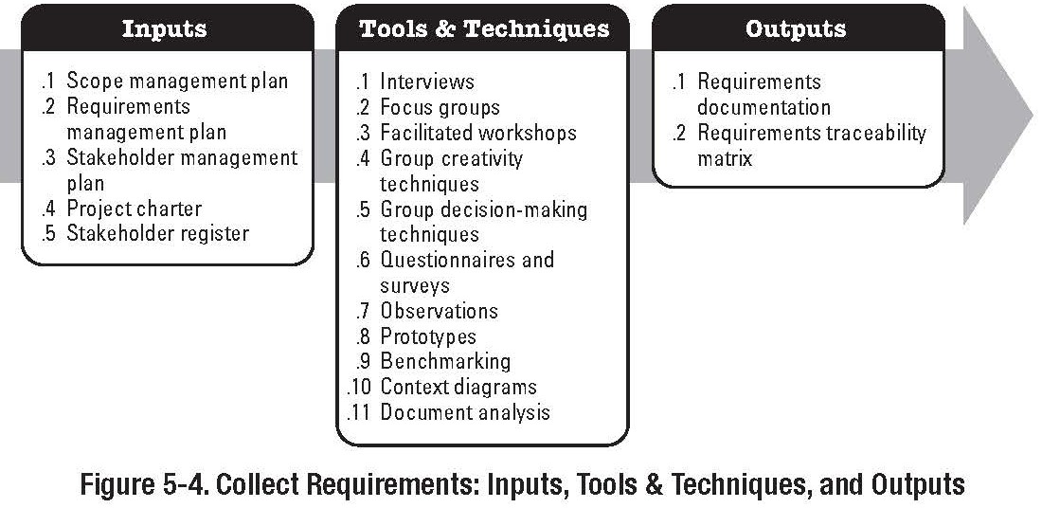
Project Management
Project Scope Management Introduction
Collect Requirements
Part of the Planning Process Group

Slide 5
Project Management
Project Scope Management Introduction
Collect Requirements
Tools and Techniques
Interviews:
Formal or Informal to discover information from Stakeholders
May be one-to-one or one-to-many Focus Groups:
Brings together pre-qualified stakeholders in order to learn about their needs wants and expectations
Trained Moderator leads the discussion

Slide 6
Project Management
Project Scope Management Introduction
Collect Requirements
Tools and Techniques
Facilitated Workshops:
Brings Cross Functional Stakeholders together in a controlled manner
Build Trust, Improve communications, Increased Stakeholder consensus
Group Creativity Techniques:
Brainstorming, Nominal Group Technique, The Delphi Method, Idea/Mind Mapping, Affinity Diagram
Refer to book for all

Slide 7
Project Management
Project Scope Management Introduction
Collect Requirements
Tools and Techniques
Group Decision Making Techniques Unanimity, Majority, Plurality, Dictatorship
Questionnaires and Surveys Observations
Direct Observation (shadowing), Participant Observer Prototypes
Not easy in Construction, perhaps through 3D Design Visualisation Techniques

Slide 8
Project Management
Project Scope Management Introduction
Collect Requirements Outputs
Requirements Documentation Refer to Book
Functional Requirements
Non Functional Requirements Acceptance Criteria
Support and Training Requirements Requirements Management Plan
How changes will be controlled Requirements Traceability Matrix
Links Requirements to project objectives, scope, WBS, Design, etc.

Slide 9
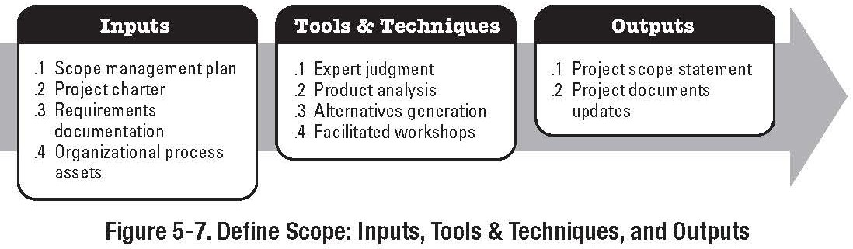
Project Management
Project Scope Management Introduction
Define Scope
Part of the Planning Process Group

Slide 10
Project Management
Project Scope Management Introduction
Define Scope
Inputs
Refer to book:
Project Charter Requirements Documents
Organizational Process Assets Tools & Techniques
Expert Judgment, Product Analysis, Alternatives Identification, Facilitated Workshops

Slide 11
Project Management
Project Scope Management Introduction
Define Scope
Product Analysis:
It is a method of converting product descriptions (drawings, specs, etc.) and project objectives (build times, build costs) into deliverables and requirements.
Included Techniques such as product breakdown, systems analysis, system engineering, value engineering, value analysis, and functional analysis

Slide 12
Project Management
Project Scope Management Introduction
Define Scope
Stakeholder Analysis
Identifying Stakeholders Understanding Stakeholder Roles
Interests, objectives, influence
Communicating with Stakeholders
Determine needs, wants, expectations Separate ‘key requirements’ from ‘wish lists’ Alternatives Identification
Technique to discover alternative methods and ways of accomplishing the project.
Brainstorming Lateral thinking

Slide 13
Project Management
Project Scope Management Introduction
Define Scope
Alternatives Identification
Technique to discover alternative methods and ways of accomplishing the project.
Brainstorming, Lateral thinking, Facilitated Workshops Involve Stakeholders
Make sure you understand Stakeholder’s Roles Interests, objectives, influence
As a facilitator; Determine needs, wants, expectations, Separate ‘key requirements’ from ‘wish lists’

Slide 14
Project Management
Project Scope Management Introduction
Scope Definition
Output
Project Scope Statement, which includes: (refer to book for details)
1 | Project Objectives | 9 | Initial Project Organisation
2 | Product Scope Description | 10 | Initial Identified Risks
3 | Project Requirements | 11 | Schedule Milestones
4 | Project Boundaries | 12 | Fund Limitations
5 | Project Deliverables | 13 | Cost Estimate
6 | Product Acceptance Criteria | 14 | Config MGMT Requirements
7 | Project Constraints | 15 | Project Specifications
8 | Project Assumptions | 16 | Approval Requirements

Slide 15
Project Management
Project Scope Management Introduction
Define Scope
Project Objectives should be SMART
Specific Measurable Accurate
Realistic and Tangible
Time Bound Project Deliverables
measurable outcomes, measurable results, and specific items that must be produced to consider the project (or project phase) complete.

Slide 16
Project Management
Project Scope Management Introduction
Define Scope
Project Acceptance Criteria
Processes (tests) and criteria for acceptance by the client.
i.e. WT plant, producing 10 MLD of potable water compliant with EU regs.
Project Constraints Time constraints Budget constraints Quality constraints
Schedule constraints Technology constraints

Slide 17
Project Management
Project Scope Management Introduction
Project Assumptions
When you ‘assume’ you make an ‘ass’ out of ‘u’ and ‘me’Q You can’t know everything, so you will have to make assumptions.
For PM, it is vital that you record all assumptions and get the project sponsor to sign off on those assumptions
Typical internal assumptions would be the availability of key personnel and/or equipment for a project
Typical external assumptions would be that the client (sponsor) will have necessary all planning permissions.

Slide 18
Project Management
Project Scope Management Introduction
Scope Statement
Provides the basis for making future decisions in relation to scope changes
Intended to make sure that all stakeholders have a common knowledge of what the project entails Addresses 7 key questions:
Who, What, When, Why, Where, How, How many
The Elephants Child - Rudyard Kipling (1902)
I keep 6 honest serving men,
(they taught me all I knew), Their names are What and Why and When,
And How and Where and Who.

Slide 19
Project Management
Project Scope Management Introduction
Scope Statement v. Statement of Work (SOW)
Scope Statement is generated by the PM team Statement of Work is generated by the client
Statement of Work is a narrative description of the end results to be provided under the contract
For construction contracts, the SOW typically provides the basis for the Scope Statement

Slide 20
Project Management
Project Scope Management Introduction
Scope Statement and SOW
Both the client and the contractor must ‘sign-off’ on the Scope Statement and SOW.
SOW is normally written into the contract and therefore signed off on.
An order of priority must also be agreed.
i.e. SOW is typically given priority over the Scope Statement. If a discrepancy arises between the documents the SOW will be upheld.

Slide 21
Project Management
Project Scope Management Introduction
Misinterpretation
Common Causes
Mixing tasks, specifications, approvals, and special instructions
Using imprecise language
‘nearly’ ‘optimum’, ‘approximately’, etc.
No pattern, structure or chronological order Wide variation in size of tasks
Wide variation in how to describe details of work Failing to obtain third-party review

Slide 22
Project Management
Project Scope Management Introduction
Misinterpretation
Fixes
In an effort to avoid pitfalls a number of private and public bodies have issued guidelines for the preparation of Scope Statements and SOWs
NASA SOW Guidance Available from: www.hq.nasa.gov/office/procurement/newreq1.htm

Slide 23
Project Management
Project Scope Management Introduction
Advantages of Scope Statements
Enables client and contractor to understand the project requirements and needs.
Reduces claims and disputes under the contract by identifying potential issues early in the project.
Forces Designers, Engineers, PM team, QS team, CM team, etc. to re-examine the SOW in detail.
(typically post tender, and pre-contract signing)
Minimises RFIs and Change Orders; and the delays associated.
Provides a clear baseline for performance that covers the virtually every aspect of the project.
Clarifies acceptance tests and criteria early in the project.

Slide 24
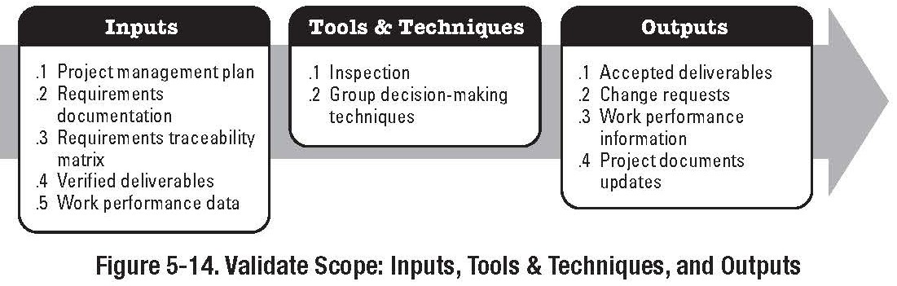
Project Management
Project Scope Management Introduction
Validate Scope
Part of the Monitoring & Controlling Process Group

Slide 25
Project Management
Project Scope Management Introduction
Scope Validation
Scope Validation is carried out over the entire project duration, not just at the start
Initial Validation involves obtaining the stakeholders formal acceptance of the project scope and associated deliverables.
This first Scope Statement is referred to as the ‘Baseline Scope Statement’
Thereafter, Scope Validation is involved with checking and verifying that project deliverables and requirements are being met in accordance with the Scope Statement

Slide 26
Project Management
Project Scope Management Introduction
Scope Validation
Cont. . .
Validation includes inspections to ensure that Project Deliverables are being met and accepted.
If Project Deliverables are not being accepted, the validation process records the reasons for rejection.
Rejection typically leads to Requested Changes, which are passed to the Integrated Change Control Process to identify potential impacts on time, cost, etc.
Rejection can also lead to Corrective Actions (ie Rework)

Slide 27
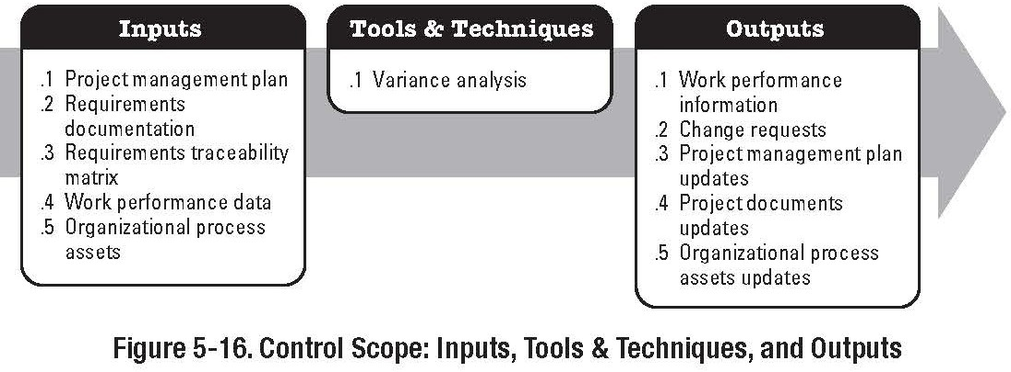
Project Management
Project Scope Management Scope Control
Control Scope
Part of the Monitoring and Controlling Process Group

Slide 28
Project Management
Project Scope Management Scope Control
Control Scope
Scope Creep. . . There is no such thing as scope creep, only scope gallop Q
AKA ‘kitchen sink syndrome’ Q
It is a gradual process, by which additional (unauthorized) work is added to the original project
If not properly handled, it can destroy a project and a Project Manager’s reputation.

Slide 29
Project Management
Project Scope Management Scope Control
Scope Creep
Provided it is controlled, it is not always a bad thing Can lead to increased profitability of a contract
Sometimes used by the unscrupulous as a means to bargain for an EOT to a contract
Additional works anticipated to take 2 weeks
propose to carry out the works on condition that an EOT of 3 weeks is granted.
New DoF Contracts make this very difficult

Slide 30
Project Management
Project Scope Management Scope Control
Control Scope
Inputs:
Partially covered; refer to book Outputs (refer to book for details)
Work Performance Measurements Organisational Process Assets Updates
Change Requests - Scope control does not mean always saying ‘no’
Project Management Plan Updates
Scope Baseline Update
Other Baseline Updates (Time, Cost, etc.)
Project Document Updates - Requirements Documents, etc.

Slide 31
Project Management
Project Scope Management Scope Control
Control Scope Tools and Techniques
Variance Analysis:
Determination of the magnitude of variations Determination of the cause of variations
Some variations are borne by the client; others by the contractor
Re-planning
Approved change requests can effect the project scope usually require changes to the WBS, WBS dictionary, Schedules, Scope Statement, PM Plan etc.
Change Control System
Impact assessment, documentation, authorization, etc.

Slide 32
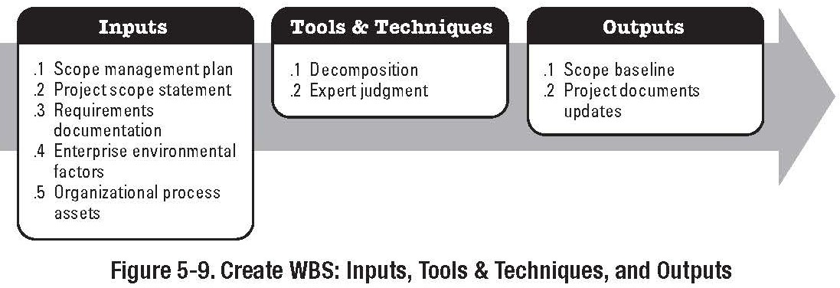
Project Management
Project Scope Management Work Breakdown Structure
Create Work Breakdown Structure
Part of the Planning Process Group

Slide 33
Project Management
Project Scope Management Work Breakdown Structure
Work Breakdown Structure
A hierarchical decomposition of the total scope of work to be carried out by the project team to accomplish project objectives and create the required deliverables.
PMBOK®definition.. P567

Slide 34
Project Management
Project Scope Management Work Breakdown Structure
Work Breakdown Structure
The importance of the WBS cannot be over emphasized Failure to develop a sufficiently detailed WBS will lead to:
Scheduling issues Procurement issues
Costing and Budgeting issues Status Reporting issues
Unclear delegation of responsibilities Etc.

Slide 35
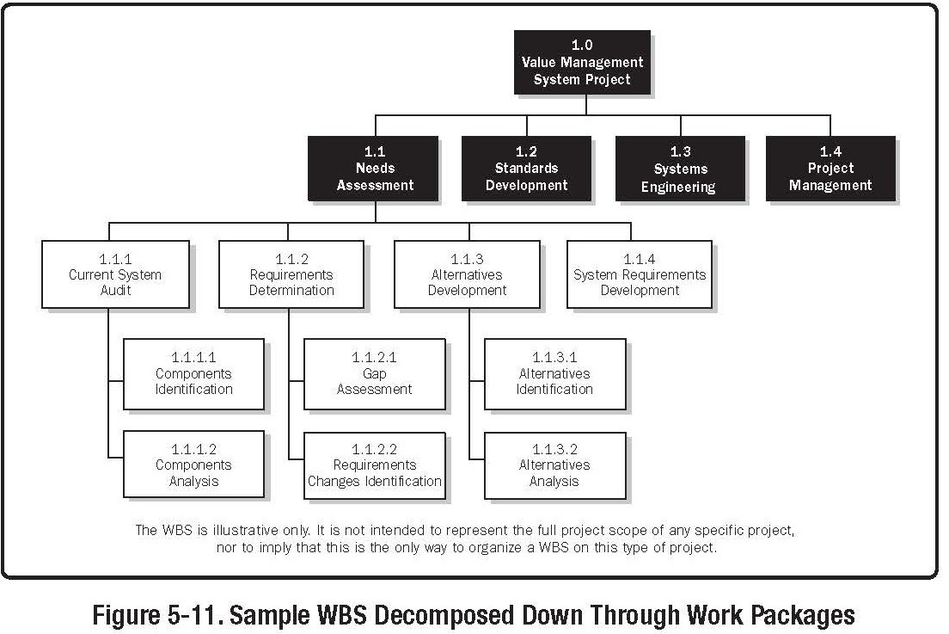
Project Management
Project Scope Management Work Breakdown Structure

Slide 36
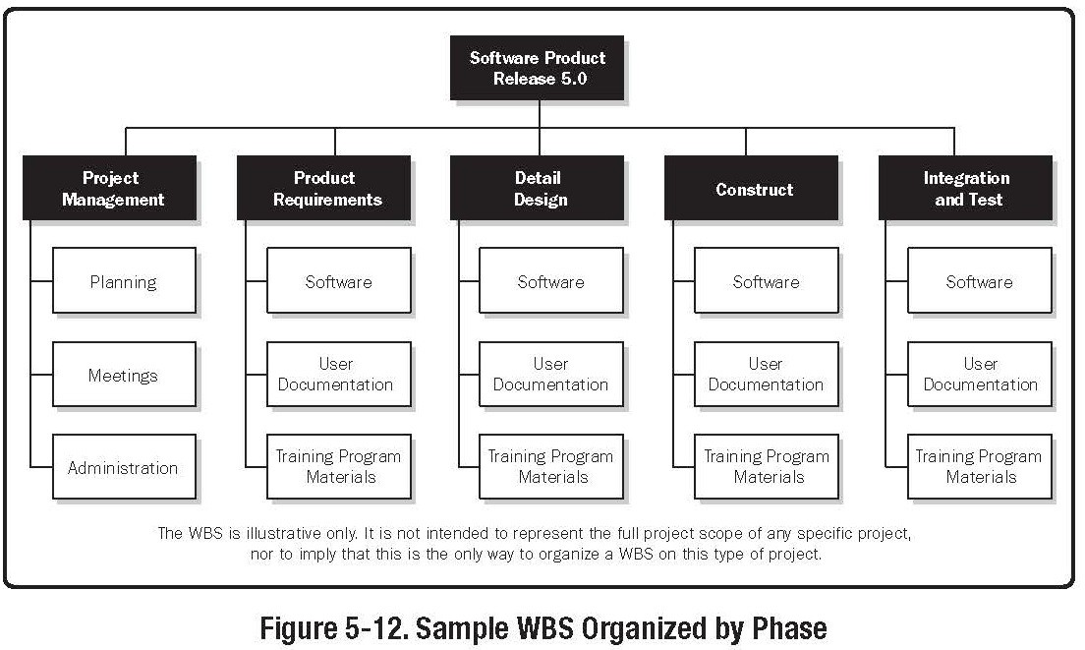
Project Management
Project Scope Management Work Breakdown Structure

Slide 37
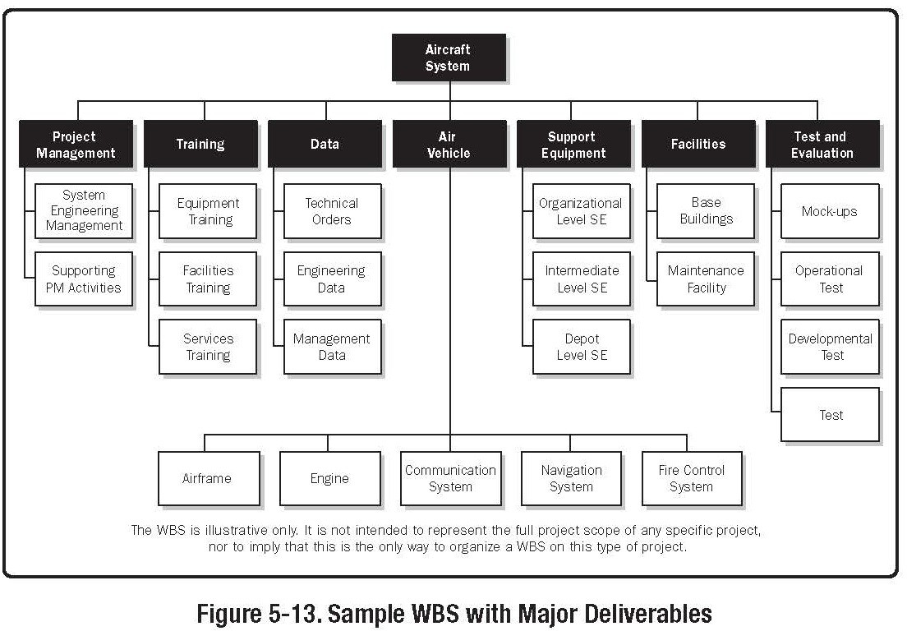
Project Management
Project Scope Management Work Breakdown Structure

Slide 38
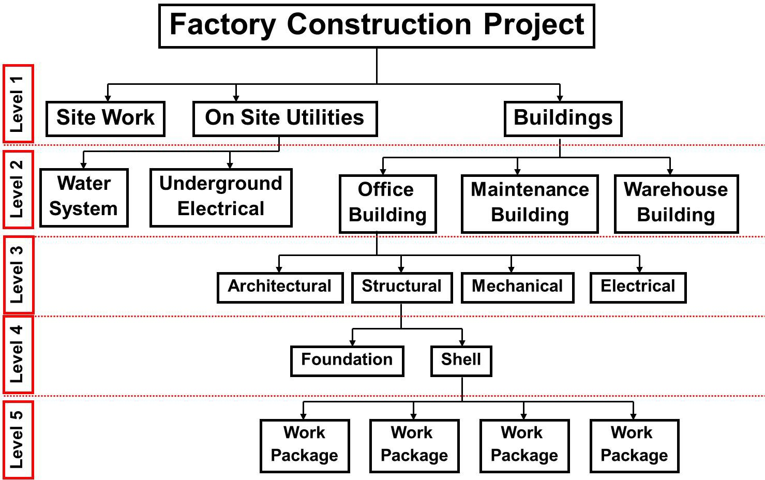
Project Management
Project Scope Management Work Breakdown Structure
Sample WBS

Slide 39
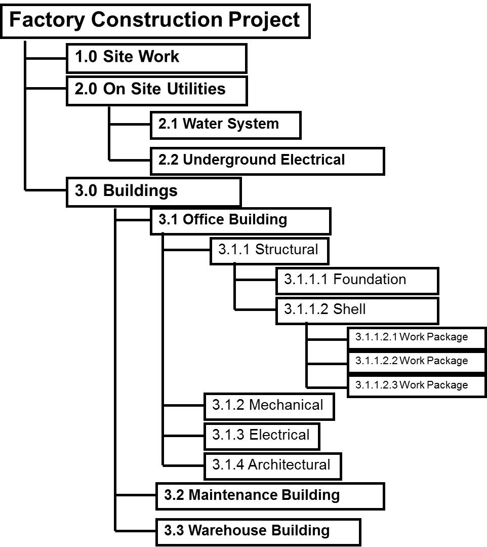
Project Management
Project Scope Management Work Breakdown Structure
Sample WBS with Numbering Scheme

Slide 40
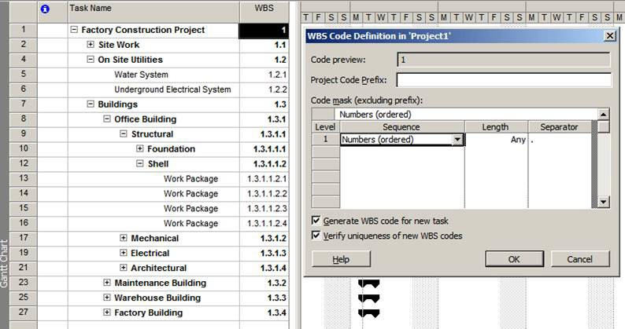
Project Management
Project Scope Management Work Breakdown Structure
MS Project
MS Project has WBS code functionality included use Project — WBS — Define Code

Slide 41
Project Management
Project Scope Management Work Breakdown Structure
WBS Levels
Dependant upon project, but in general: Level 1 - Total Program
Level 2 - Project Level 3 - Task Level 4 - Subtask
Level 5 - Work Package Level 6 - Level of Effort
Managerial Levels - 1 to 3 (Project Manager) Technical Levels - 4 to 6 (Line Managers)

Slide 42
Project Management
Project Scope Management Work Breakdown Structure
When the project (and work to be completed) is organised in this way it provides a framework for:
Planning to be performed
Costs and Budgets to be established Time, cost and performance to be tracked
Schedules and Status reporting procedures to be established
Responsibility for delivery of elements to be established and tracked
Risk Analysis
Development of an Organisation Structure and Responsibility Matrix
By breaking down the overall project into its constituent elements, the probability that every major and minor component will be completed is increased.

Slide 43
Project Management
Project Scope Management Work Breakdown Structure
More on Levels. . .
The upper 3 levels of the WBS are usually specified by the customer (SOW)
Level 1 is generally used for authorization and release of all work
Level 2 is generally used for budget preparation Level 3 is generally used for schedule preparation
The lower 3 levels are generated by the contractor for in-house control

Slide 44
Project Management
Project Scope Management Work Breakdown Structure
Considerations when Generating a WBS
The WBS and work description should be easy to understand
All schedules should follow the WBS, not the other way around
Work should not be subdivided to the lowest possible level
- it is inefficient
The WBS normally changes over the course of a project; build in flexibility
The WBS can act as a list of milestones that can be used to assist communication project progress
The WBS can be used to segregate recurring from non-recurring costs
Most WBS elements range from 0.5% to 2.5% of the total project budget - 200 to 40 items

Slide 45
Project Management
Project Scope Management Work Breakdown Structure
WBS tasks and sub-tasks
WBS tasks should:
Have clearly defined start and end dates
Be usable as a communications tool in which results can be compared with expectations
Be estimated on a ‘total’ time duration, not when a task should start and end
Necessary for correct scheduling and network analysis

Slide 46
Project Management
Project Scope Management Work Breakdown Structure
Work Packages
Characteristics:
Represents the units of work at the level where the work is performed
Clearly distinguishes one work package from all others assigned to a functional group
Contains clearly defined start and end dates that are representative of physical accomplishment (done after scheduling)
Specifies a budget in terms of money (e), man-hours, or other measurable units
Limits work to be performed to relatively short periods of time.
Minimises Work in Progress

Slide 47
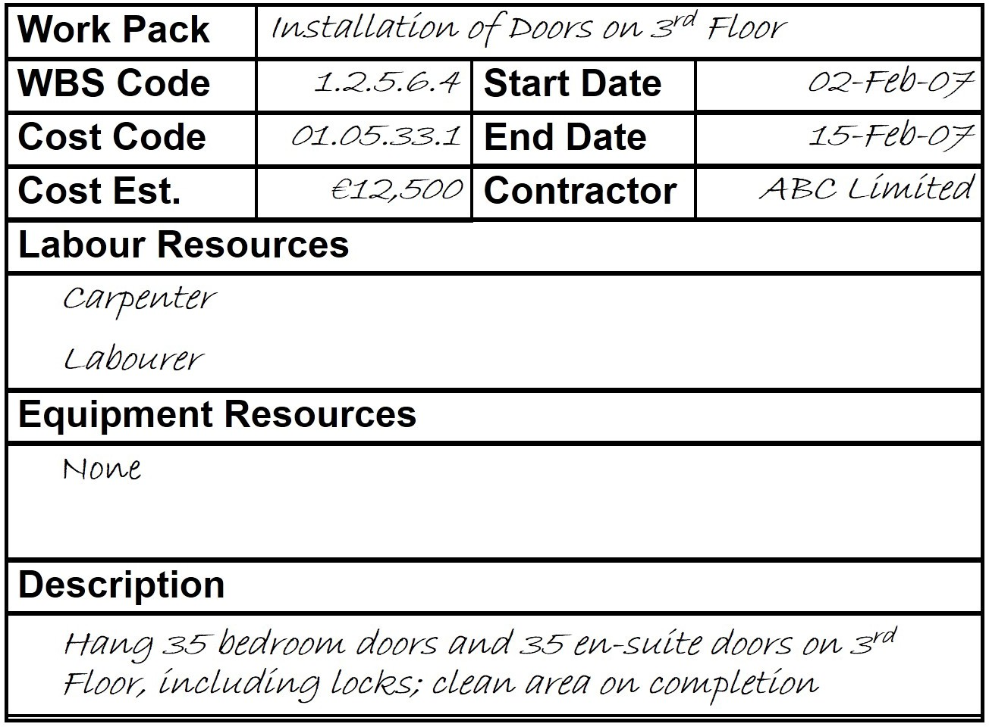
Project Management
Project Scope Management Work Breakdown Structure
Example Work Package

Slide 48
Project Management
Project Scope Management Work Breakdown Structure
WBS Dictionary
The WBS dictionary is a companion document to the WBS The WBS dictionary describes the WBS elements in terms of:
Account Code identifier
Description of work & resources required Organisation responsible
Milestones
Contractual Information Quality Requirements Associated schedule activities Estimate of Cost
See Work Package Header

Slide 49
Project Management
Project Scope Management Work Breakdown Structure
WBS Checklist
Check the WBS for
Completeness
Anticipated effort (time & resources) Compatibility
Continuity
Ensure it satisfies both functional and project requirements
Check that the WBS provides a logical subdivisions of project work
Ensure that elements can be assigned to specific individuals and/or groups
Check the WBS against project reporting requirements

Slide 50
Project Management
Project Scope Management Work Breakdown Structure
WBS for Sub-Contracting
Develop a preliminary WBS for top 3 levels
Ensure the Sub-contractor develops the WBS for all lower levels, and submits this information as part of their proposal and reaffirms as part of the sub-contract.
Ensure that the Sub-contractors WBS is compatible with project reporting requirements and the SC’s own reporting and management procedures
In short, a Sub-Contractors WBS should be capable of full integration into the project WBS, including elements such as
Cost, Schedule, Resources, etc.

Slide 51
Project Management
Project Scope Management Work Breakdown Structure
WBS Decomposition Problems
Whilst Levels 1 to 3 can be fairly standard for most construction projects, Levels 4 to 6 can be very difficult to generate
Breaking down work to small and detailed packages may require the creation of hundreds of cost accounts and charge numbers
The costs associated with producing detailed work packages may outweigh the benefits
The WBS forms the basis of Arrow Diagrams and Precedence Diagrams. At low levels of the WBS, the number of interconnections and dependencies over complicate the network, and can render it impossible to interpret.

Slide 52
Project Management
Project Scope Management Work Breakdown Structure
WBS Standardisation
Many companies who execute projects of similar nature will standardise the top 3 levels of the WBS.
By standardising the top levels of the WBS organisations can compare previous projects, deliverables, costing, execution etc.
Standardisation also lessens the time taken to develop detailed WBS
Standardisation aids communications, and facilitates the transfer of resources and equipment between projects.

Slide 53
Project Management
Project Scope Management Work Breakdown Structure
WBS Process Outputs
WBS
WBS Dictionary Scope Baseline
Project Document Updates
Typically during the generation and review of the WBS previously unidentified elements arise. These may need to be incorporated into the project, and therefore the Project Scope, and Work Breakdown Structure may require updating through the Integrated Change Control Process

